Slide 1
Chronic Obstructive Pulmonary Disease (COPD) & Asthma
Danielle Shelton
March 27, 2017

Slide 2
Objectives
What is COPD & asthma?
Briefly COPD vs Cystic Fibrosis
What causes these diseases?
Who suffers from them & the prevalence.
How they can hinder an individual’s life.
Economic Burden
Interventions & Prevention
Research & Data

Slide 3
COPD

Slide 4
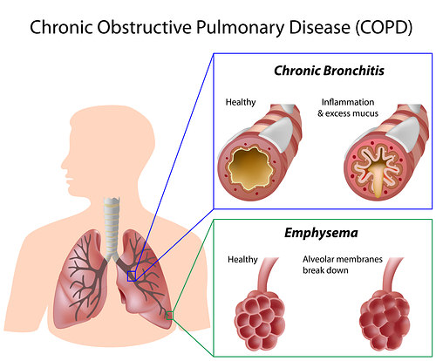
What is COPD?
Chronic Obstructive Pulmonary Disease isn’t one disease. It’s actually a group of diseases that cause airflow blockage and breathing-related problems. Primary diseases are emphysema and chronic bronchitis. Some doctors will include asthma but the disease etiology is different. → May be diagnosed with asthma-COPD overlap syndrome due to similar symptoms.
Bronchitis = Inflammation of the lining of bronchial tubes, which carry air to and from the lungs
Emphysema = The gradual damage of lung tissue, specifically the thinning and destruction of the alveoli or air sacs, making it progressively difficult to breathe

Slide 5
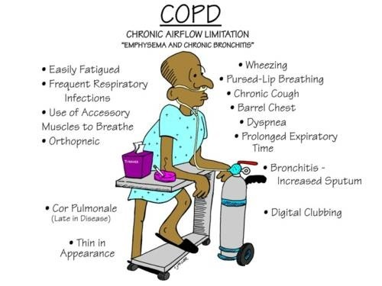
Common symptoms that occur with COPD:
Chronic Cough (Smoker’s Cough)
Chronic phlegm (sputum) production
Shortness of breath while doing things you used to be able to do
Not being able to take a deep breath
Wheezing
Notes:
Symptoms will vary for each person

Slide 6
What CAUSES IT

Slide 7
What causes these diseases?
Tobacco smoke (primary)
Air pollutants in the home and workplace
Genetic factors
Persistent respiratory infections
Indoor air quality as well but more so in developing countries than the US
In 2014, the third leading cause of death in the US was chronic lower respiratory disease, primarily COPD!
~around 15.7 million Americans reported being diagnosed with COPD (this is likely an underestimate) → so who suffers the most?

Slide 8
WHO SUFFERS & PREVALENCE

Slide 9
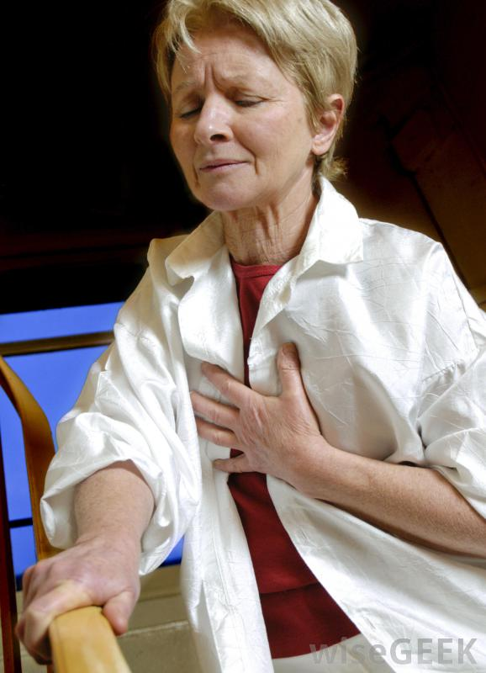
Those who suffer.
In 2013, these specific groups were identified as more likely to report COPD:
People aged 65-74 years and 75 + years
American Indian/Alaskan Native and multiracial non-Hispanics
Women
Individuals who were unemployed, retired, or unable to work
Individuals with less than a high school education
Individuals who were divorced, widowed or separated
Current or former smokers
People with a history of asthma

Slide 10
Incidence of Chronic Bronchitis & Prevalence of Emphysema
In 2014:
8.7 million adults were diagnosed with chronic bronchitis in the past year (3.6% of the US population)
3.4 million adults said that they been diagnosed with emphysema (1.4% of the US population)
Data from National Health Interview Survey administered by the CDC. - Yearly Household Survey

Slide 11
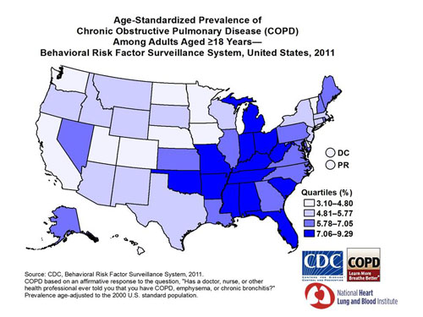
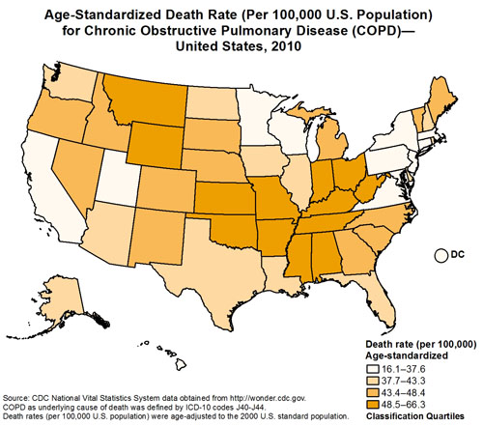
COPD Prevalence in the US (2011)
Geography also seems to influence COPD prevalence, with the highest following the Mississippi river. Mortality rate and morbidity prevalence maps look very similar.
Death rates have declined among US men from 1999 to 2010 in the US, but no significant change has been documented in women.
Death rate in 1999: Deathrate in 2010:
Men: 57.0 per 100,000 vs 47.6 per 100,000
Women: 35.3 per 100,000 vs 36.4 per 100,000
Notes:
CDC Wonder website is where they obtained the National Vital Statistics Death Certificate data.
https://www.cdc.gov/copd/data.htm

Slide 12
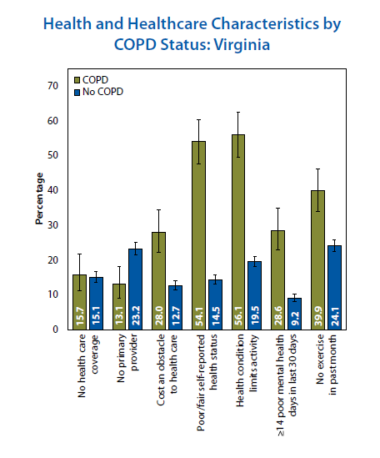
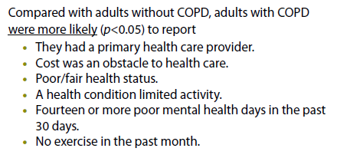
COPD in VA (2011)
6.1% (age-adjusted = 5.8%) of Virginia residents surveyed in 2011 reported having been told they have COPD by a healthcare professional
https://www.cdc.gov/copd/maps/docs/pdf/VA_COPDFactSheet.pdf

Slide 13
HOW IT HINDERS YOUR LIFE

Slide 14
Why COPD can severely hinder your life?
Daily activities become difficult (walking/climbing stairs) - some have to go on oxygen therapy (O2 tank)
Unable to work
Research has found that people have disengaged from social activities (eat out, religious outings, etc.)
Increased ER visits and overnight hospital stays
Increased confusion and memory loss
Increased comorbidities, primarily other chronic diseases (arthritis, congestive heart failure, coronary heart disease, stroke, or asthma)
Increased depression and other mental conditions
Increased reporting of fair and poor health status
Source: https://www.cdc.gov/copd/index.html

Slide 15
Copd vs cystic fibrosis

Slide 16
Are they similar?
No,
They both do affect the respiratory system and lower one’s quality of life, energy levels, and even appearance and can also result in death BUT
COPD is more prevalent than pulmonary fibrosis (cystic fibrosis)
COPD is OBSTRUCTIVE - causes lung damage and airway narrowing that results in exhaled air coming our more slowly than normal, making it harder to breathe during daily activities and exercise
Cystic Fibrosis is RESTRICTIVE – the lungs themselves are restricted from fully expanding. This can be due to:
Stiffness of the chest, weak muscles, damaged nerves or internal scarring
Notes:
COPD – essentially you can’t exhale all of the air out of your lungs before you need to take the next inhalation
Source: https://lunginstitute.com/blog/copd-vs-pulmonary-fibrosis-heres-what-you-need-to-know/

Slide 17
Do you get them the same way?
No,
As mentioned, COPD is usually the result of direct inhalation of smoke and other harmful particulates → the obstruction to breathing occurring from airway inflammation and emphysema
Cystic fibrosis however is not always directly connected to the inhalation of smoke and other inhalants but can be the result of genetic predisposition
You need 2 copies of the defective gene in order to have the disease (with one copy from only one parent then you are a carrier)
The odds if both you and your spouse are carriers:
25 percent (1 in 4) the child will have CF
50 percent (1 in 2) the child will be a carrier but will not have CF
25 percent (1 in 4) the child will not be a carrier and will not have CF
Notes:
https://lunginstitute.com/blog/copd-vs-pulmonary-fibrosis-heres-what-you-need-to-know/
https://www.cff.org/What-is-CF/About-Cystic-Fibrosis/
The defective CF gene contains a slight abnormality called a mutation. There are more than 1,700 known mutations of the disease. Most genetic tests only screen for the most common CF mutations. Therefore, the test results may indicate a person who is a carrier of the CF gene is not a carrier.

Slide 18
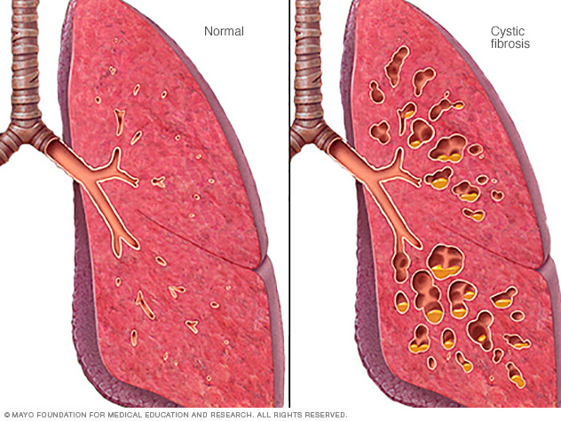
So what exactly is cystic fibrosis?
Cystic Fibrosis (or Pulmonary Fibrosis) = scarring of the lungs
An excessive buildup of scar tissue occurs causing the thickening of the walls in the lungs → reduced oxygen supply to the blood and leads to shortness of breath
Over 5 million people suffer worldwide from this disease (30,000 here in the US)
Notes:
Sources: https://lunginstitute.com/blog/copd-vs-pulmonary-fibrosis-heres-what-you-need-to-know/ & https://www.cff.org/What-is-CF/About-Cystic-Fibrosis/

Slide 19
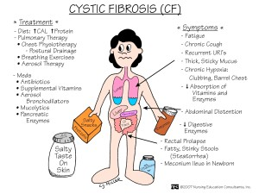
Is it treatable?
Yes, through
Medication that:
Loosen and get rid of mucus
Open airways and thin mucus
Improve absorption of vital nutrients
Oxygen Therapy
Research: In 2015, the FDA approved the second drug to treat the root cause of cystic fibrosis, a defective protein known as CFTR. The first drug targeting the basic genetic defect in CF was approved in 2012.
Notes:
The arrival of this group of drugs, called CFTR modulators, signals a historic breakthrough in how CF is treated. It's expected that CFTR modulators could add decades of life for some people with CF.
https://www.cff.org/What-is-CF/About-Cystic-Fibrosis/

Slide 20
ASTHMA

Slide 21
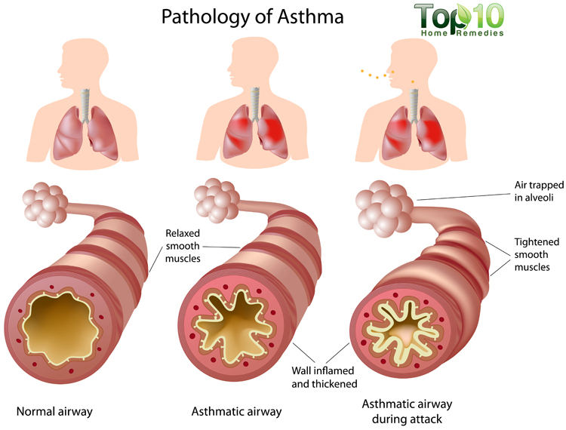
What is asthma?
Asthma is defined as a chronic inflammatory disease affecting the airways in the lungs. During an asthma attack, airways become inflamed, making it very difficult for individuals to breathe.
There are varying degrees of asthma from mild to severe.
Symptoms include:
Coughing
Shortness of breath
Wheezing
Tightness/pain in chest
Asthma diagnosis can be a risk factor for COPD later in life (WHO).
Notes:
So similar symptoms to COPD BUT not the same

Slide 22
WHAT CAUSES IT?

Slide 23
What causes asthma?
We don’t know!
Genetic & Environmental Factors
An inherited tendency to develop allergies (atopy → at – o – pee )
Parents with asthma (Family History)
Certain Respiratory Infections during Childhood
Contact with some airborne allergens or exposure to some viral infections in infancy or in early childhood when the immune system is developing
Hygiene Hypothesis - the theory that our Western lifestyle with the emphasis on hygiene and sanitations has resulted in a decline in childhood infections so many young children no longer have the same types of environmental exposures and infections as children did in the past → this affects their developing immune system and it may increase their risk for atopy and asthma
Source: https://www.nhlbi.nih.gov/health/health-topics/topics/asthma/causes

Slide 24
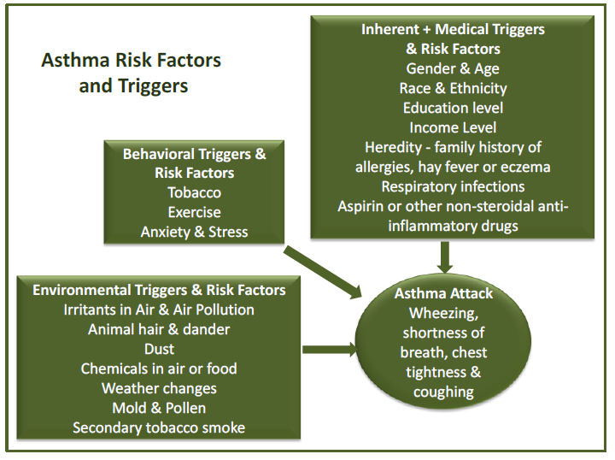
What triggers asthma & asthma attacks?
Environmental factors & triggers:
Intrinsic (nonallergic) - infections
Extrinsic (allergic) - including dust, mold, pollen, cigarette smoke or animal hair/dander, chemicals in the including air pollution, perfume and other chemicals
Also changes in temperature
Behavioral triggers: smoking, exercise and heightened anxiety/stress
Genetic risk factors: family history of allergies, hay fever or eczema may predispose an individual towards asthma
Nonmodifiable & Other Factors: gender, age, racial groups and ethnicities have higher asthma incidence; education and income level, as well as medical conditions such as respiratory infections and use of certain medications.
Notes:
Environmental Triggers: Cause Irritation or Allergic Reaction Resulting in an asthma attack
Behavioral factors have been known to trigger asthma attacks
Education and Income Level influence your likelihood of developing asthma. In 2009, adults who didn’t finish high school were more likely to have asthma than adults who graduate high school or college. And adults with an annual household income of $75,000 or less were more likely to have asthma than adults with higher incomes. (This data was from the BRFSS Asthma Call-Back Survey)
Data from: Asthma Burden Report (Virginia Department of Health, 2016)
http://www.vdh.virginia.gov/content/uploads/sites/75/2016/12/Asthma-Burden-Report-.pd

Slide 25
Varying Diagnosing Codes for Asthma
Allergic (Extrinsic) Asthma - allergens trigger your asthma symptoms
Non-allergic (Intrinsic) Asthma - most likely are suffering from asthma following an infection that settles in your chest, usually bacterial
Chronic Obstructive Asthma - this would be the overlap COPD/asthma syndrome
Exercise Obstructive Asthma - airflow obstruction due to exercise (my sister & I)
Notes:
Data from: Asthma Burden Report (Virginia Department of Health, 2016)
http://www.vdh.virginia.gov/content/uploads/sites/75/2016/12/Asthma-Burden-Report-.pdf
Allergic is usually diagnosed young while COA is diagnosed older.
Exercise is usuaully is teens and young adults.

Slide 26
WHO SUFFERS & PREVALENCE

Slide 27
Who has it? -- Asthma Prevalence in the US
Prevalence:
In 2014, CDC reported that ~ 24,009,000 currently have asthma (7.7% of population)
~ 6 million were children ( <18 years) & ~ 18 million were adults
Boys have a higher prevalence than girls but women have a higher prevalence than men
~ 10.1 % boys vs 7.0 % girls
~ 9.6% women vs 5.1% men
Racial distribution is also varied.
White NH: 7.6%
Black NH: 9.9%
Hispanic: 6.7%
Data retrieved from: CDC 2014 National Health Interview Survey Data
 | Number with Current Asthma (2014)
0 - 4 years | 4.3 %
5 - 14 years | 10.3 %
15 - 19 years | 9.1 %
20 - 24 years | 8.9 %
25 - 34 years | 7.5 %
35 - 64 years | 7.3 %
65 + years | 6.9 %
Asthma can be thought to just be a childhood disease, this isn’t really the case. It’s a childhood diagnosis but follows you through your life.
Notes:
This data was retrieved from the Centers for Disease Control and Prevention (CDC) national and state surveillance systems. Last updated March 2016
These differences are not well understood and believed to be a combination of biological, sociocultural, and environmental differences among sexes. Another compelling argument for gender differences is that sex hormones may play a part in the immune function and lung processes in regards to asthmatic gender differences

Slide 28
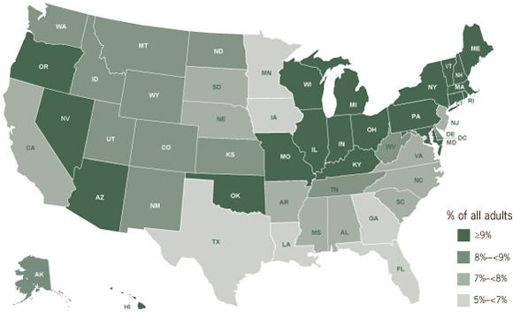
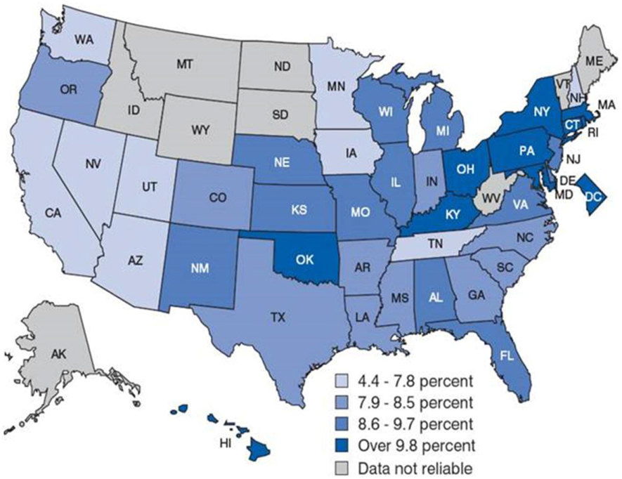
Distribution of the disease
Generally higher in the Northeast region of the US.
→ could be attributed to higher air pollution (ozone and PM2.5)
→ cold air can trigger an asthma attack as well BUT so can hot and humid conditions
Adults with Asthma in the US, 2009
Childhood asthma prevalence in the US, 2001-2005
Source: Behavioral Risk Factor Surveillance System, 2009
Source: CDC/ NCHS, National Health Interview Survey, annual average for the period 2001-2005
Notes:
https://www.cdc.gov/vitalsigns/asthma/

Slide 29
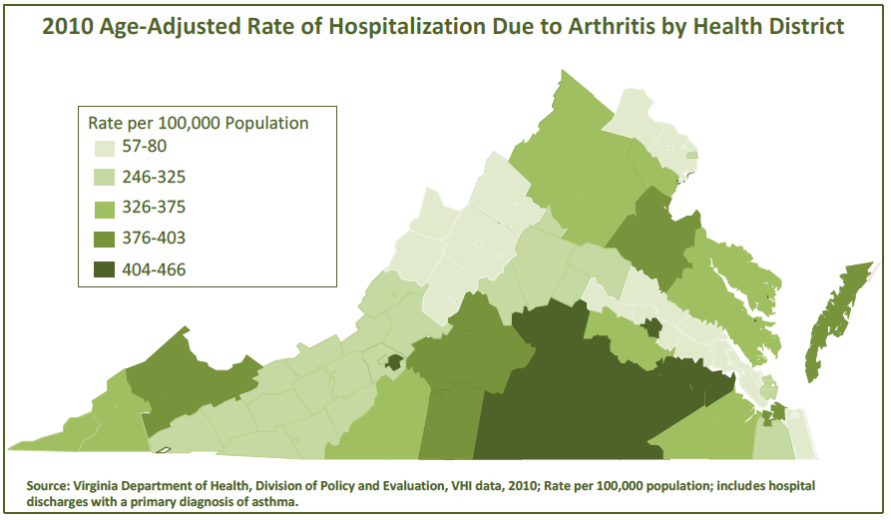
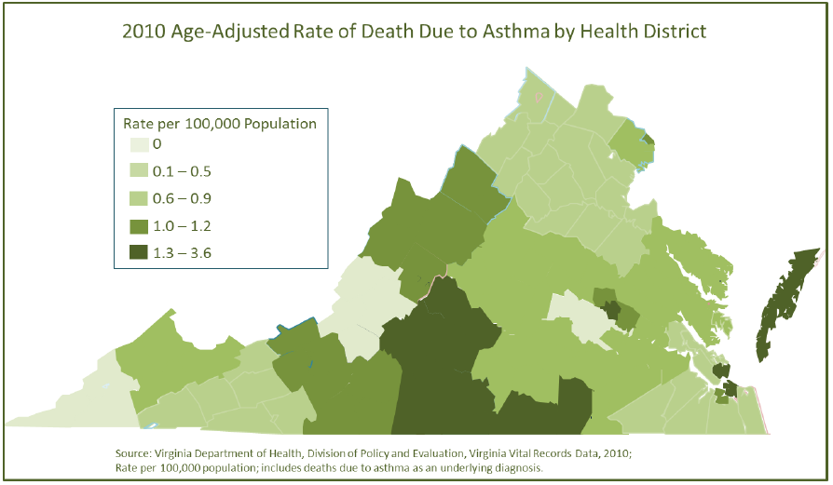
VA Distribution of Asthma
In 2010, 788,458 adults in VA reported having been told by a physician that they had been diagnosed with asthma; this represents 12.8% of total population (this isn’t including the child population)
Asthma
Notes:
Data from: Asthma Burden Report (Virginia Department of Health, 2016)
http://www.vdh.virginia.gov/content/uploads/sites/75/2016/12/Asthma-Burden-Report-.pdf

Slide 30
HOW IT HINDERS YOUR LIFE

Slide 31
Physical/Mental Limitations Imposed by the Disease
Looked at asthma-specific Health-related Quality of Life (HRQL) as experienced by primary school-aged asthmatic children
5 focus groups interviewed and found that asthma influenced the life of children:
Physically, emotionally, & socially
What affected HRQL most was:
Peer Relationships (Being Bullied), Dependence of Medication, Shortness of Breath, Cough, Limitation of Activities, & Limitations due to the response on cigarette smoke exposure
Source: https://www.ncbi.nlm.nih.gov/pmc/articles/PMC2823668/
Notes:
Source: https://www.ncbi.nlm.nih.gov/pmc/articles/PMC2823668/

Slide 32
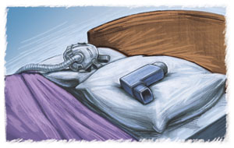
Physical/Mental Limitations Imposed by the Disease
Many people do find that symptoms do improve over time with reduced frequency of asthma attacks. HOWEVER, serious complications can develop that make adult life difficult as well:
Decreased ability to carry out activities of daily living including exercise
Impact on sleep due to attacks at night time
Long term reduction in lung function
Persistent cough
Difficult breathing (some requiring a ventilator)
Death
Source: Virginia Department of Health http://www.vdh.virginia.gov/content/uploads/sites/94/2016/07/AsthmaBurdenReport.pdf

Slide 33
ECONOMIC BURDEN

Slide 34
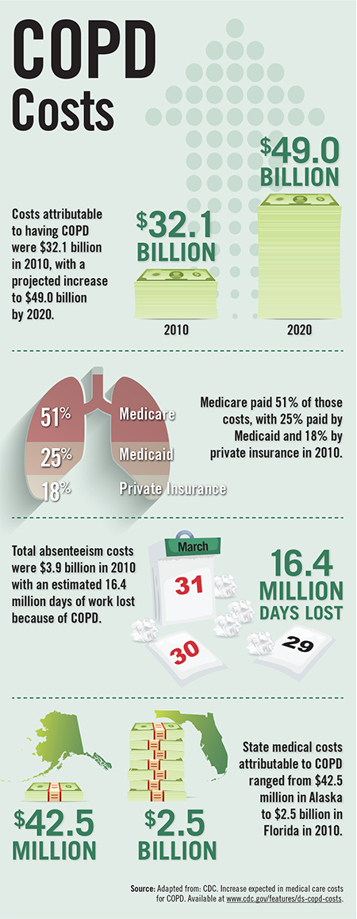
Financial Impact Upon the Healthcare System
In 2013:
Asthma - Costs the US roughly $56 billion each year
COPD - Costs the US roughly $50 billion* each year
In 2013:
$1,039 each year to manage asthma for one child
$4,000 each for the average COPD patient
In 2008, asthma caused:
10.5 million days of missed school days
14.2 million missed work days
Source: https://www.cdc.gov/asthma/pdfs/asthma_facts_program_grantees.pdf & Guarascio, A. J., Ray, S. M., Finch, C. K., & Self, T. H. (2013). The clinical and economic burden of chronic obstructive pulmonary disease in the USA. ClinicoEconomics and Outcomes Research, 5, 235-245. doi:10.2147/ceor.s34321

Slide 35
Prevention & interventions

Slide 36
Prevention - Community Interventions
Home visits are beneficial in improving asthma outcomes (looking for multi-trigger, multi-component environmental exposures) (https://www.cdc.gov/asthma/interventions/community_guide.html)
Education efforts in regards to self-management is not adequate for adults with current asthma (https://www.cdc.gov/mmwr/preview/mmwrhtml/mm5635a4.htm)
Create asthma-friendly schools for kids! CDC developed a guide for districts and schools → (https://www.cdc.gov/healthyschools/asthma/creatingafs/index.htm) & so did NIH → (https://www.nhlbi.nih.gov/health-pro/resources/lung/asthma-management-school-guide)
This site helps people with asthma navigate insurance → (http://publichealth.gwu.edu/departments/healthpolicy/CHPR/newsps/asthma/AsthmaDraftSpecs.pdf)
This site shows a list of effective interventions that have had success that could be implemented in YOUR community and it is broken down by age! → (https://www.cdc.gov/asthma/interventions/default.htm)
Notes:
Overall, each community is different and will need different requirement to fulfill the needs of it’s asthma & COPD patients.

Slide 37
Primary Prevention for Asthma & COPD
Reduction & avoidance of personal exposure to risk factors (should be started in childhood for COPD) → we don’t know what causes asthma therefore harder to prevent diagnosis
Highly important to avoid tobacco and tobacco smoke
Find out the level of air pollution in your area http://vadeq.tx.sutron.com/
Write to your local officials about lowering legal pollutant levels in your region
COMMUNITY EFFORT! Must be a collaboration between school, work, healthcare, etc. in order to reduce exposure to disease determinants and pollution risks.
TRANSPARENCY! The public needs a clear and simple message for what constitutes a healthy lifestyle from nutritional habits to regular exercise to avoidance of tobacco, airway irritants, and allergens.
Notes:
Resource: http://www.who.int/respiratory/publications/strategy/en/index5.html

Slide 38
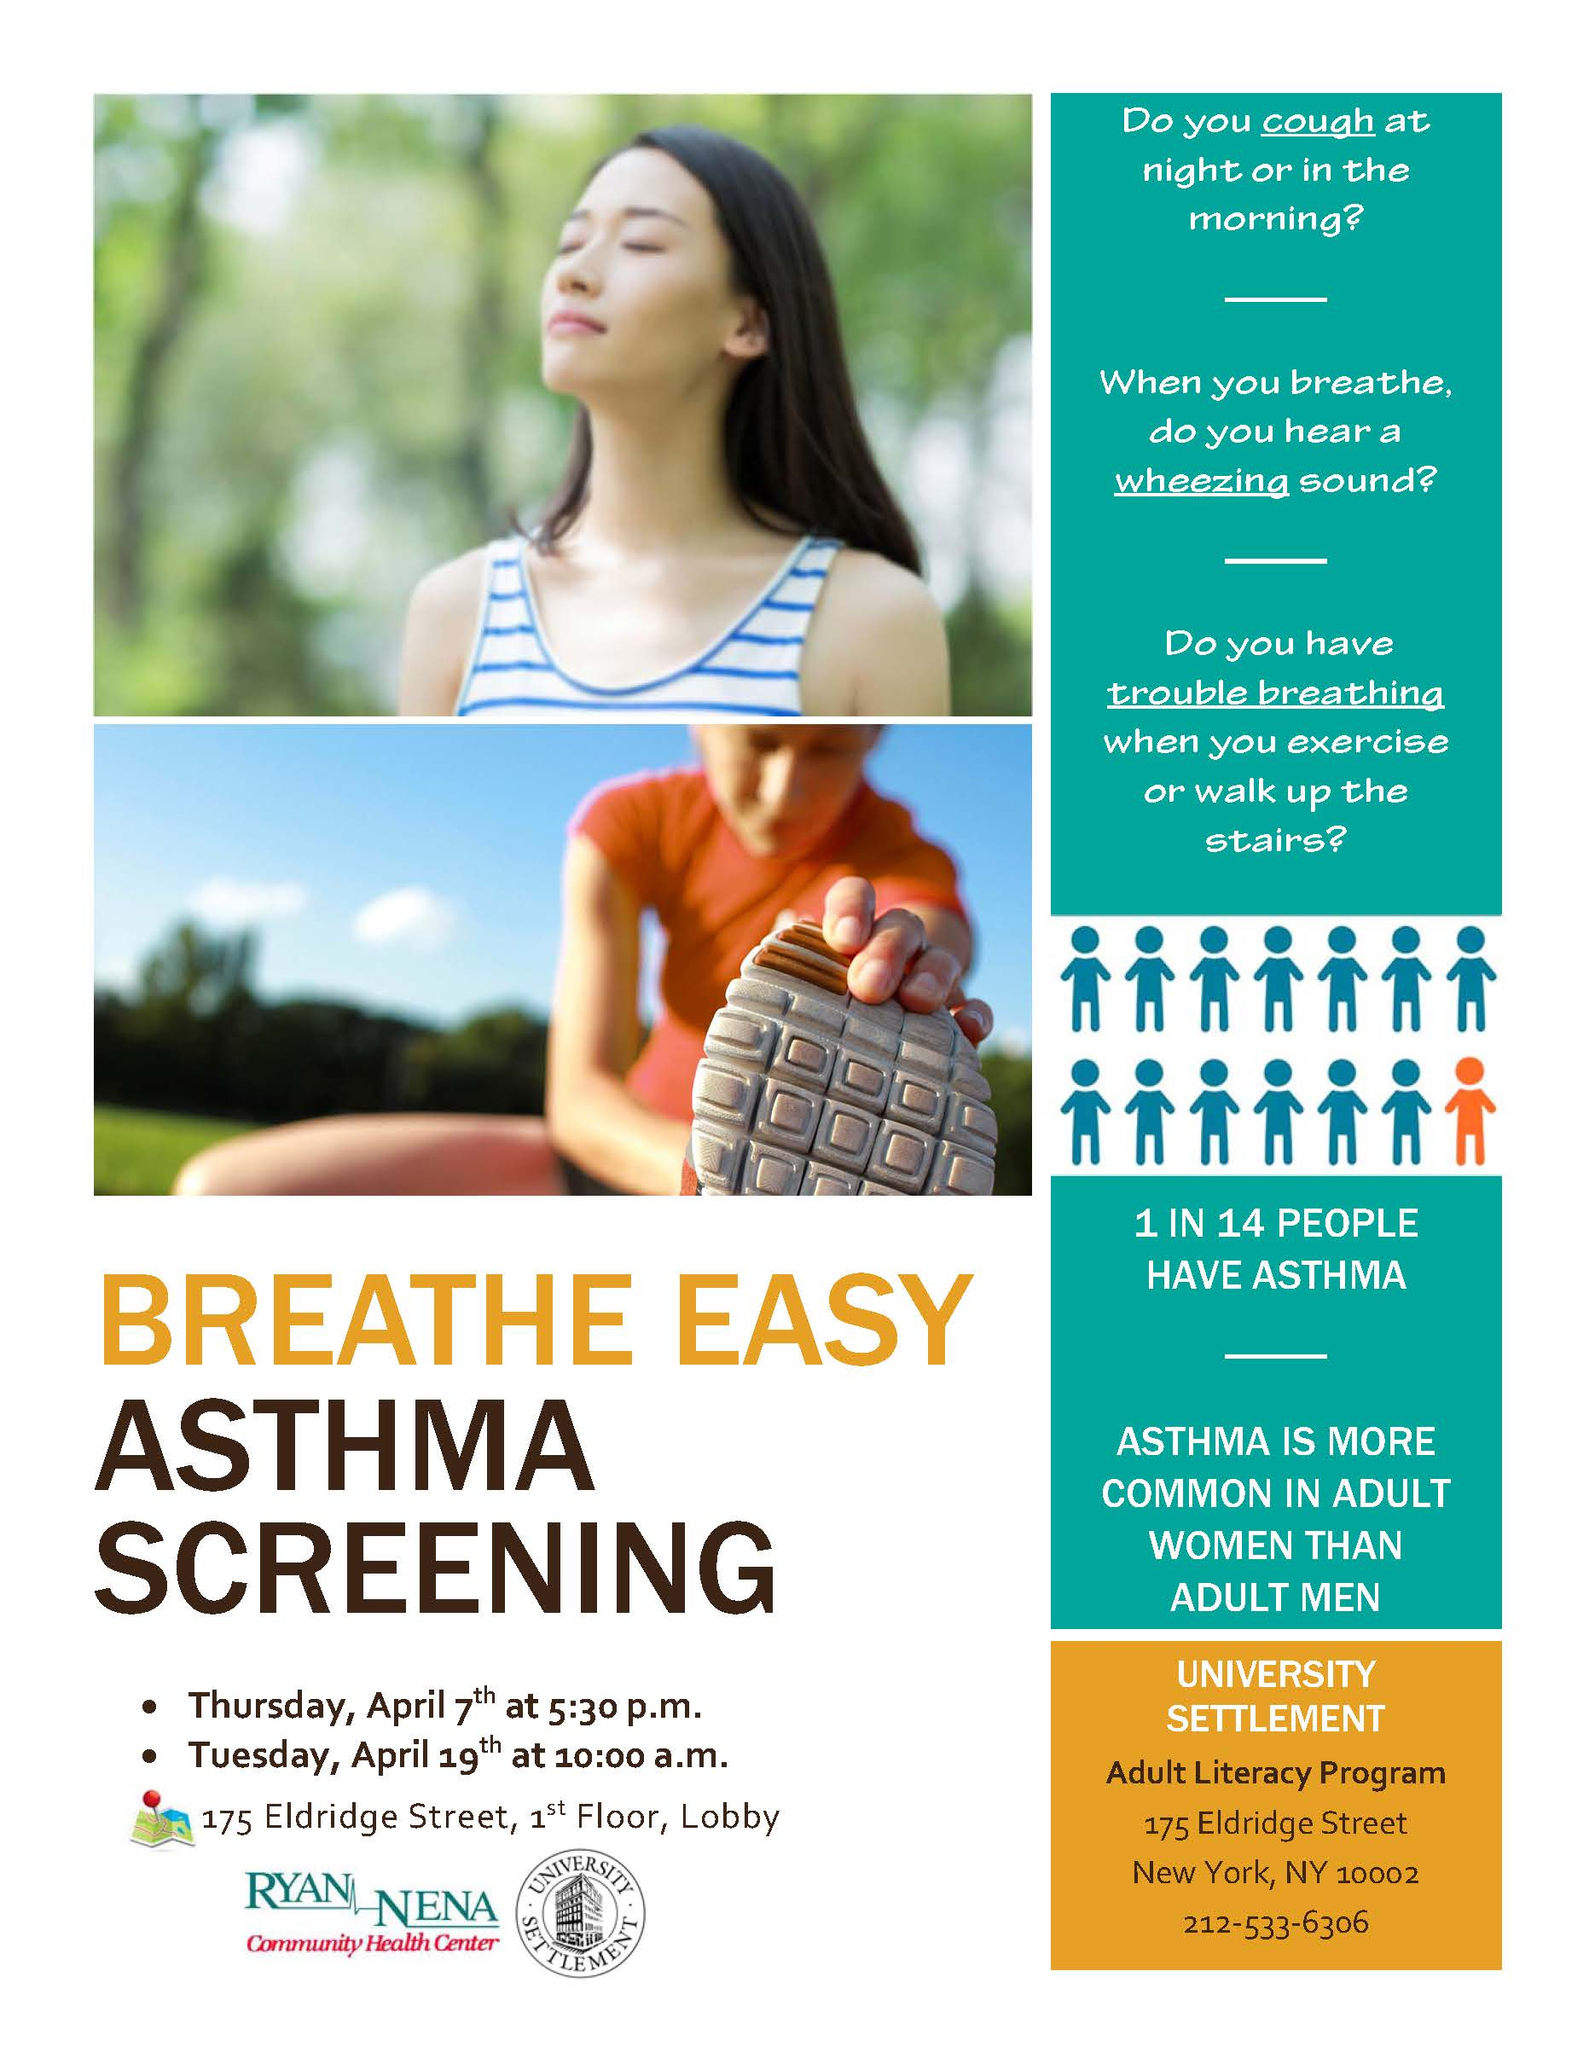
Secondary Prevention
Good screening patterns to increase diagnosis so that people can properly manage and reduce exposure to triggers
the cost effectiveness of large scale early detection programs have yet to be evaluated
Early detection of occupational asthma as well to prevent further disease progression and ensure cost-effective management
Talk with your healthcare provider about being tested for COPD using a spirometry (breathing test)
Notes:
Resource: http://www.who.int/respiratory/publications/strategy/en/index5.html

Slide 39
Tertiary Prevention
Long term decline in lung function may NOT be reversible BUT effective management of the disease can lessen symptoms and make disease burden more manageable.
Quit smoking
Participate in pulmonary rehabilitation
Oxygen Therapy
Reduce exposure to noxious particles and gases
Some research has also indicated that influenza vaccination is also a cost-effective intervention method for patients with COPD.
For asthma:
Learn what your triggers and allergens are and avoid them
Learn the proper pharmacological treatment to control your asthma & prevent chronic symptoms
http://knowyourcount.com/
Notes:
Resource: http://www.who.int/respiratory/publications/strategy/en/index5.html

Slide 40
Pulmonary Rehabilitation & Oxygen Therapy Explained
Pulmonary Therapy = Program of exercise, education, and support to help you learn to breathe and function at the highest possible level.
Can shorten hospital stays
Increase your ability to participate in everyday activities
Improve quality of life
Oxygen Therapy = A device will deliver oxygen to your lungs to aid in delivering oxygen to your oxygen-deficient blood. Devices can be lightweight, portable units that can take with you to run errands and get around town.
Some with COPD only use it when sleeping or during activities.
It has also been shown to improve quality of life and extend life for people with COPD

Slide 41
Tertiary - COPD Pharmaceuticals Used
Short-acting bronchodilators: open your airways to make breathing easier/usually prescribed for emergency situations
Corticosteroids:reduces inflammation in the body, making air flow easier in the lungs/usually inhalable and taken every day
Methylxanthines: usually prescribed after bronchodilators and corticosteroids, an anti-inflammatory drug that relaxes the airway muscles/ daily pill
Long-acting bronchodilators: used to treat COPD over a longer period of time/usually inhaled once or twice daily/ gradual release so not rescue medication
Combination Drugs: mainly combinations either of two long-acting bronchodilators of an inhaled corticosteroid and a long-acting bronchodilator
Roflumilast (Daliresp) - relieves inflammation, which improves airflow to your lungs/ daily oral pill/ usually with bronchodilator
Different types of medications treat different aspects and symptoms so it’s important to talk to your doctor about your specific disease to help find the best drug and dose combination for your lifestyle.
Source: http://www.healthline.com/health/copd/drugs#Introduction1

Slide 42
Tertiary - Asthma Pharmaceuticals Used
Long-term Controllers:
Inhaled Corticosteroid (Including Combination Inhalers) - the most consistently effective long-term control medication
Long-Acting Beta-Agonists - used in combination with corticosteroids
Cromolyn and Theophylline - not preferred but used as an alternative controller
Leukotriene Modifiers - also an alternative
Immunomodulators - these modify the allergic immune response via antibodies
Quick-Relief Medications:
Short-Acting Beta-Agonists (SABAs): relax airway muscles to give muscles prompt relief to symptoms
People also use allergy medications including antihistamines, nasal sprays, eye drops, oral corticosteroids, etc.
Source: http://www.aaaai.org/conditions-and-treatments/drug-guide
Notes:
These are primarily used to control symptoms. Most of the time, people are multiple combinations of these drugs to control their asthma depending on the severeness of the disease.
I also wanted to note that some of these drugs are expensive and that individuals with this disease should be aware that there are prescription assistance programs that offer reduced cost or free medications. If you don’t know about clinics near you who offer these programs, you can usually go directly to the pharmaceutical company website or call the company to learn more about what they offer. Mention crossover.

Slide 43
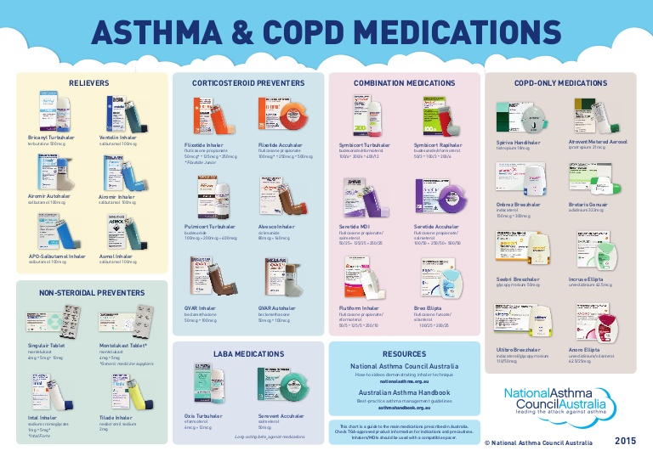
Asthma & COPD Medications
Notes:
This is from Australia but to just give you an idea of how diverse the treatment methods can be in terms of pharmaceuticals

Slide 44
Interventions: PSAs & the messages behind them
Celebrity PSA from the American Lung Association - to show you that anyone can develop it?
https://www.youtube.com/watch?v=gE2_AsaGaao
COPD Foundation Promotion - to gain knowledge?
https://www.youtube.com/watch?v=zYWlk-7jjME
Uplife Academy in Chicago PSA - to show you that your friends and loved ones may have it to & that it doesn’t have to control your life?
https://www.youtube.com/watch?v=bEp2fakobtM
CDC’s PSA about COPD & Tobacco Use - to scare you?
https://www.youtube.com/watch?v=n3rprwtTJvw

Slide 45
Research & the data

Slide 46
Reliability & Validity of the Data
Where CDC gets there data from:
Asthma Call-Back Survey (Extension of BRFSS)
BRFSS Prevalence Data
NHIS Prevalence Data
Also,
National Hospital Ambulatory Medical Care Survey for ED Data
National Survey of Residential Care Facilities
Death Certificate Data
Notes:
U.S. Data Limitations
Cross Sectional Data Used, Snapshot in time, Self-reported, New cohorts → Is this telling the whole story? → No

Slide 47
Major Research Efforts
American Lung Association funds a lot of research efforts for both diseases:
http://www.lung.org/our-initiatives/research/airways-clinical-research-centers/studies-that-change-lives.html
http://www.lung.org/lung-health-and-diseases/lung-disease-lookup/copd/copd-research.html?referrer=https://www.google.com/
http://www.lung.org/our-initiatives/research/airways-clinical-research-centers/
The National Heart, Lung, and Blood Institute (NHLBI) supports research aimed at treating lung disease as well
Ongoing Clinical Trials → https://www.nhlbi.nih.gov/studies/nhlbi-trials/asthma (3 trials right now: cross-sectional, longitudinal, and a genetics)
Past Research → https://www.nhlbi.nih.gov/health-pro/resources/lung#asthma
Virginia Asthma Coalition
http://www.virginiaasthmacoalition.org/resources.html

Slide 48
Suggested publications
New genetic markers for COPD discovered
https://www.sciencedaily.com/releases/2017/02/170206111830.htm
Investigators describe 13 new genetic regions associated with COPD, including four that have not previously been associated with any type of lung function. The researchers also found overlap of the genetic risk of COPD with two other lung diseases, asthma and pulmonary fibrosis. These findings create an improved understanding of the genetic basis for this deadly disease.
Study brings hope of a new treatment for asthma sufferers
https://www.sciencedaily.com/releases/2017/03/170301092543.htm
Improved treatments for people with severe asthma are a ‘step closer’ after a research team identified a breakthrough in the cause of airway narrowing. Scientists discovered that an active form of a key protein is increased and related to narrowing of the airway in people with severe asthma.
New Asthma Treatment Pill makes huge difference for Patients with Severe Asthma Symptoms
http://www.medicaldaily.com/new-asthma-treatment-pill-makes-huge-difference-patients-severe-symptoms-394082
Researchers have a new asthma pill for the first time in 20 years, which they believe will significantly improve symptoms for those with severe asthma. The drug, known as Fevipiprant, was shown to reduce asthma symptoms as well as inflammation, and it improved lung function and repaired airway linings.

Slide 49
Concluding thoughts...
Many are diagnosed with asthma at a young age so it is important to note that it is a treatable disease with preventable morbidity, not curable though.
There is no cure for COPD either but there is treatment out there that makes the symptoms manageable and can improve quality of life. BUT it is important to go to the doctor if you are having symptoms b/c many go undiagnosed.
Both diseases can have disabling symptoms if left untreated.
We need to actively pursue further research for treatment and management to lower healthcare costs and disease burden.
Notes:
http://www.who.int/respiratory/publications/strategy/en/index5.html

